Slide 1
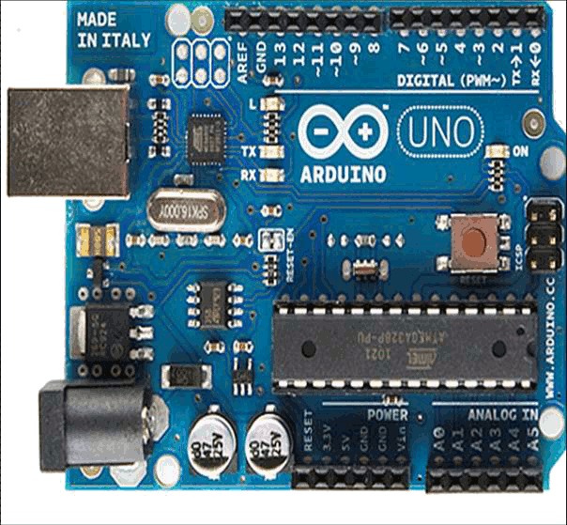
Imperial college design collective
Arduino (Genuino) workshop
27-2-2017; 7-3-2017
18:00-20:30
Avi Braun
Notes:
Few words about my self:
Physicist; EXSS; IC research fellow.
Arduin since 2013
Arduino workshop
Succesful – pulm treee project;

Slide 2

Aim
Introduce Arduino to new users: what it is good for, how to start using it, and how to develop your Arduino skills
Learning outcomes – by the end of the workshop you will…
Understand how Arduino can be used for creative or technological projects, as an educational tool, and in ones research
Know how to install and connect Arduino to your computer
Understand how to use the Arduino development environment
Understand the physical structure and layout of the Arduino
Be able to program your Arduino to read sensor(s), and to operate actuators according to logical conditions
Know how to read/send data to your Arduino from your computer
Be familiar with on-line resources that will allow you to further develop your Arduino skills

Slide 3
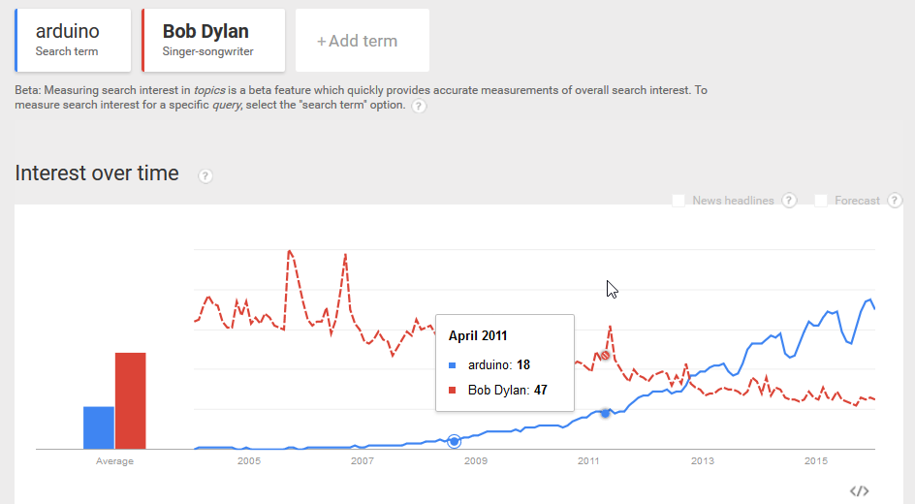
Introduction to Arduino

Slide 4
Session #1:
Introduction (30 min)
What is Arduino, and what can you do with it
Brief history of Arduino
Arduino (Uno) board overview
The Arduino ‘family’:
Shields and modules
The extended Arduino family
Likeduinos
Summary

Slide 5
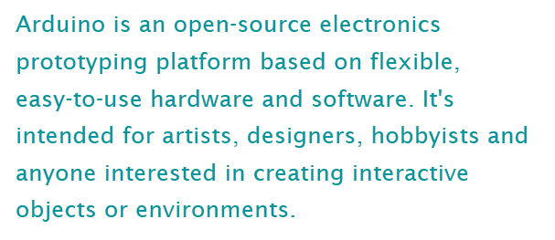
What is Arduino?
,Scientists
(www.arduino.cc)
Arduino is a tool for making computers that can sense and control more of the physical world than your desktop computer.

Slide 6
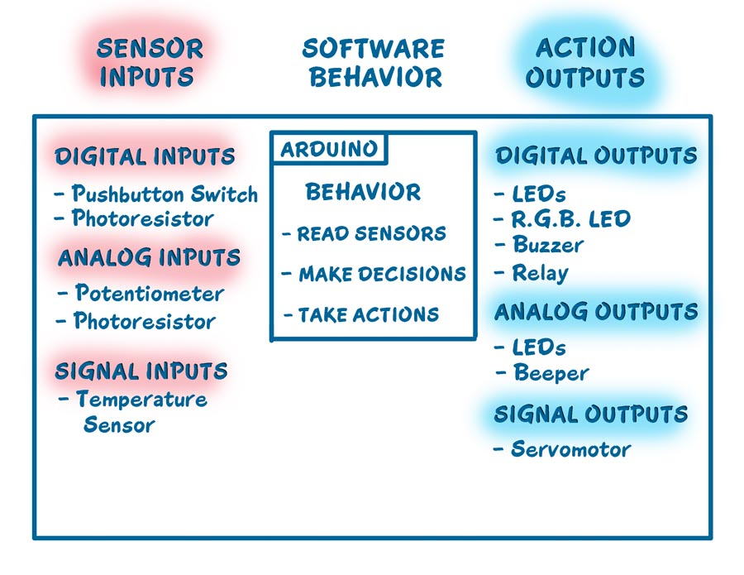
What is Arduino?
Microcontroller (Single board)
Computer: core processor, memory, clock generator, programmable Input/Output peripherals
Internet Of Things

Slide 7

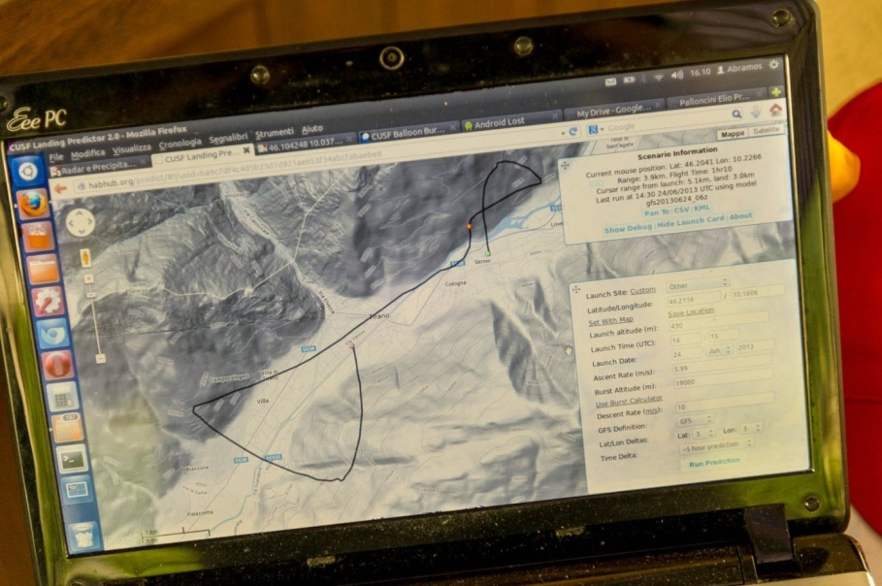
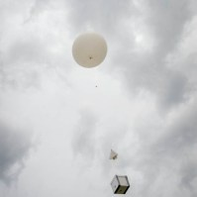
Arduino monitored High Altitude Balloon

Slide 8
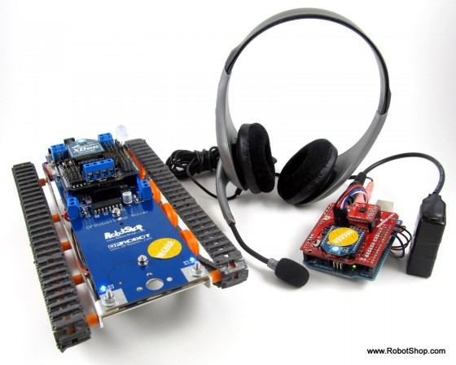
Speech-Controlled Arduino Robot

Slide 9
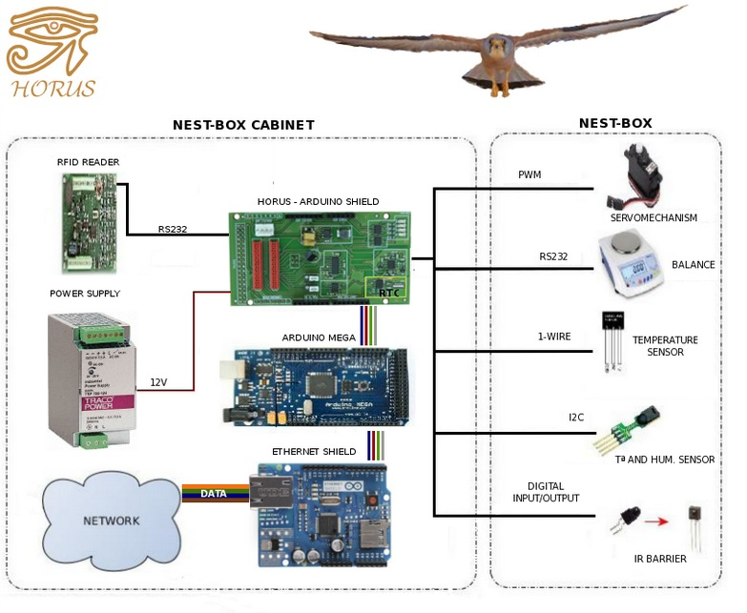
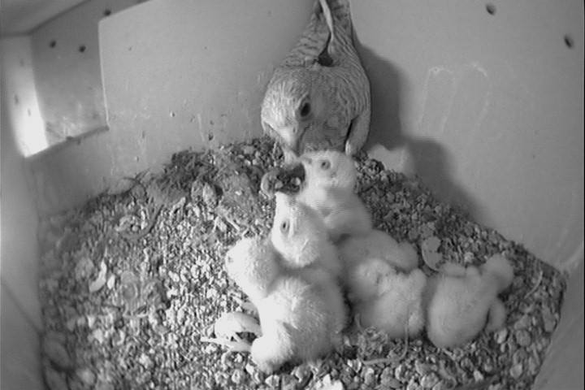
Smart nest
Smart nest

Slide 10
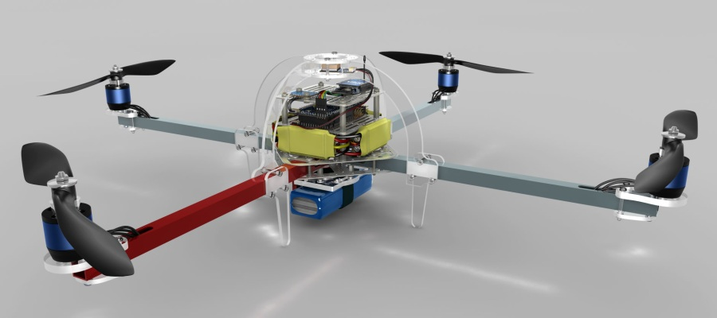

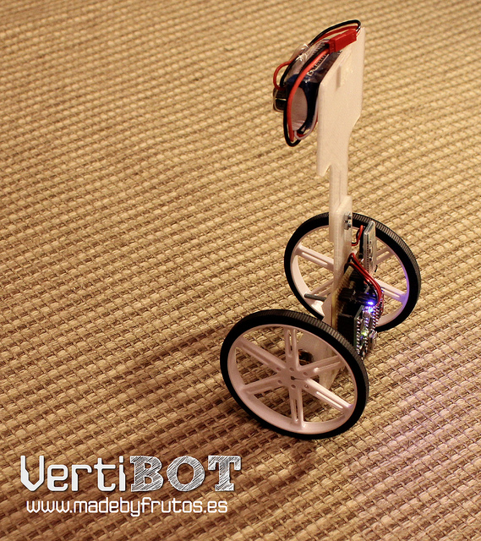
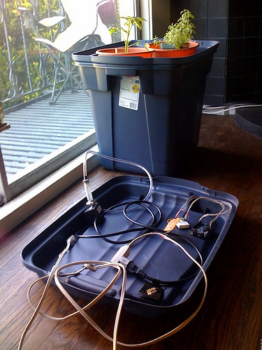
Home automation
Growduino
3D printers
Robots (autonomous and actively controlled)

Slide 11
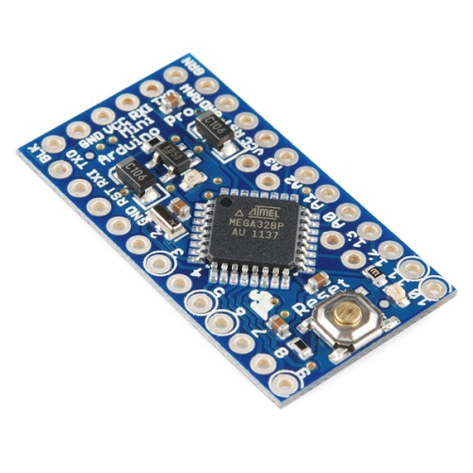
Advantages
Ready and easy to use:
USB connection
Power plug
Low cost: starting at $ 9.95 per piece
Open source
“…people should be able to study our hardware to understand how it works, make changes to it, and share those changes...” (www.arduino.cc)
Accessible:
A lot of documentation, tutorials for beginners (and experts)
Modules and shields

Slide 12
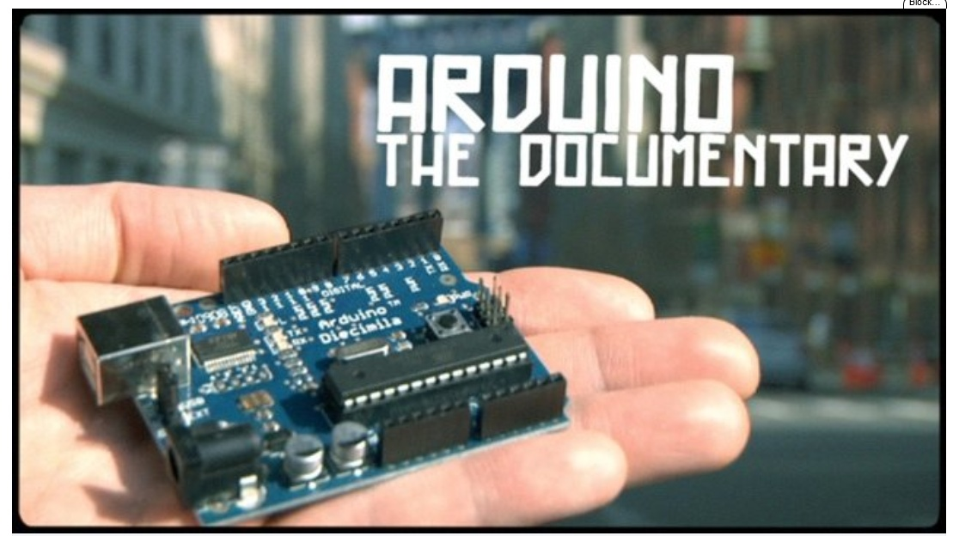
Brief history of Arduino

Slide 13
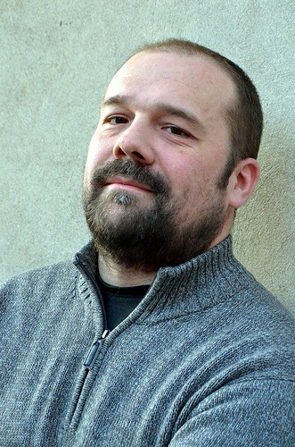
Brief history of Arduino
Born in 2005, at the Interaction Design Institute Ivrea, Italy
Massimo Banzi – the challenge: how to teach students to create electronics, fast (and cheap)
Micronotroller
Program language
Development environment
"The philosophy behind Arduino is that if you want to learn electronics, you should be able to learn as you go from day one, instead of starting by learning algebra," David Cuartielles
Democratization of engineering

Slide 14


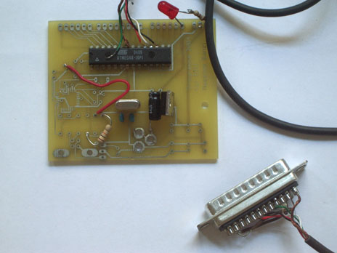
Brief history of Arduino
Development environment
‘Processing’
Program language
‘Wiring’
Microcontroller (the device)

Slide 15

Brief history of Arduino
open-source (software and hardware)
Interaction Design Institute Ivrea closed at 2010
Original design files are accessible for free
Can be used, adapted, changed and redistributed
Part of Arduino’s DNA:
New boards, modules, and a free atmosphere of sharing

Slide 16
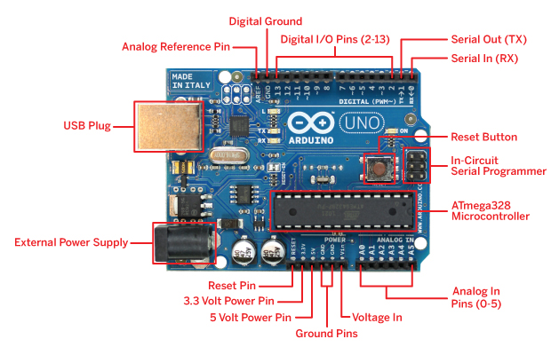
Arduino (Uno) Board Overview
Integrated LEDs:
Pin13
TX
RX
Serial communication
7-12V
10 bits
I2C (Inter-Integrated Circuit) and SPI (Serial Peripheral Interface)
5V/3.3 V

Slide 17
Arduino Board Overview (Uno)
Arduino I/O pins:
10 bits with an effective frequency of up to 8000 Hz
Output of 3.3/5V from digital pins
Maximum Ratings: DC Current per I/O Pin – 40.0 mA (tested @ 20 mA) DC Current VCC and GND Pins – 200.0 mA 1 VCC pin: can Source a total of 200mA 2 GND pins: can Sink a total of 400mA
Max data transfer speeds:115kbits(serial); 400kbits (I2C); 4Mbits (SPI)
https://sites.google.com/site/measuringstuff/the-arduino
http://arduino-info.wikispaces.com/ArduinoPinCurrent

Slide 18
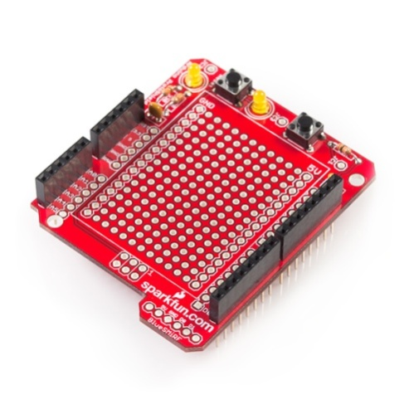
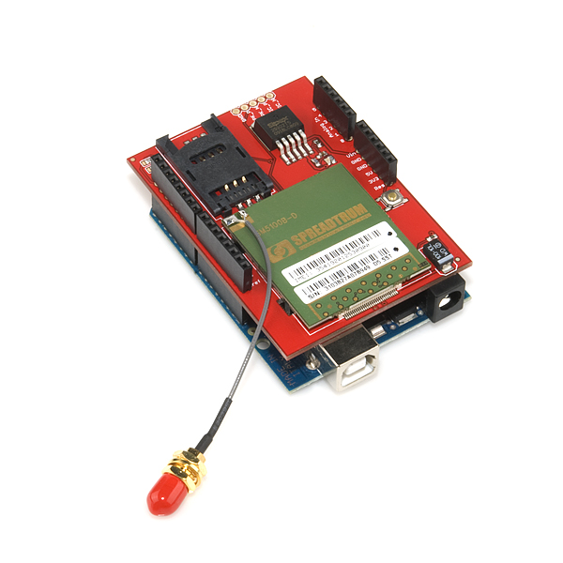
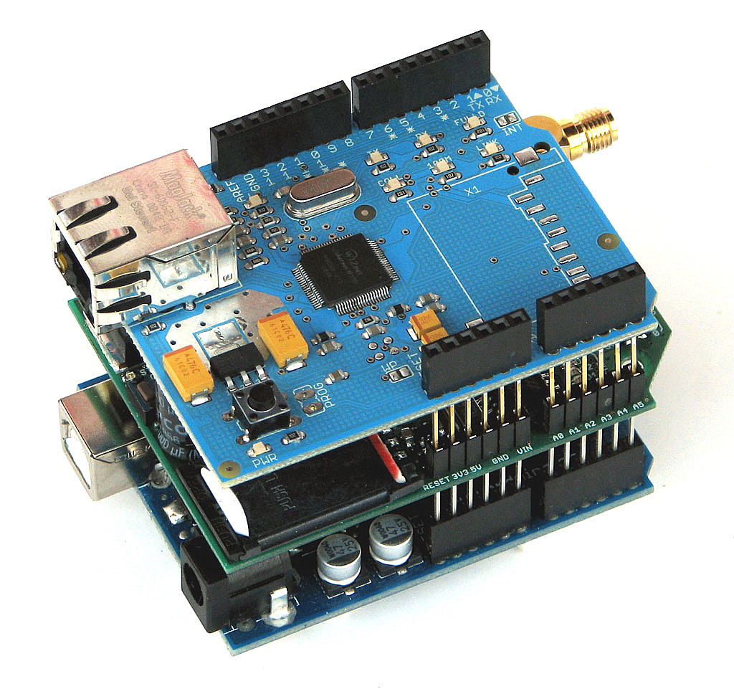
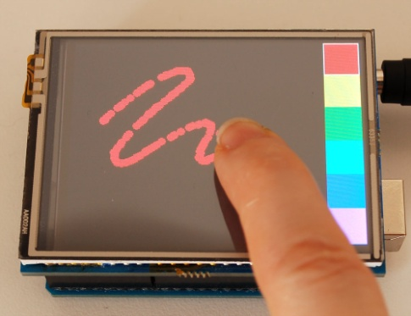
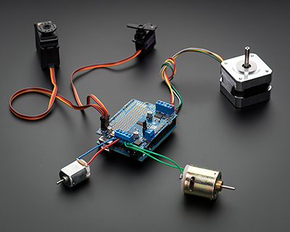
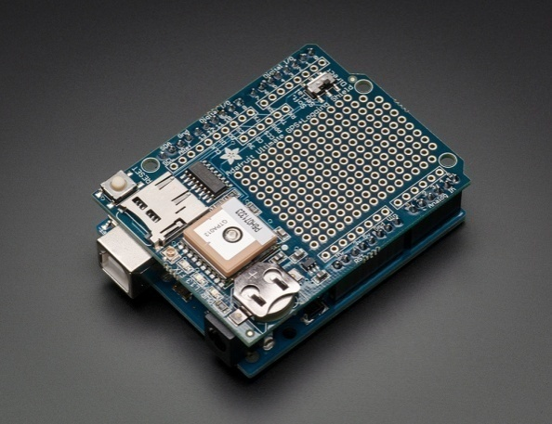
Shields and modules
Adding capabilities to the Arduino board:
GPS
SD card
Real Time Clock
Displays: LCD, touch screens
Motors: Servo/DC/Stepper
Prototype
Camera
Joystick
Notes:
Microcontroller: avaliable components

Slide 19
Shields and modules
Communication:
Bluetooth
Cellular: GSM/GPRS and others
Ethernet/wifi
Xbee
RFID
Adding capabilities to the Arduino board:
GPS
SD card
Real Time Clock
Displays: LCD, touch screens
Motors: Servo/Dc/Stepper
Prototype
Camera
Joystick
Notes:
Microcontroller: avaliable components

Slide 20
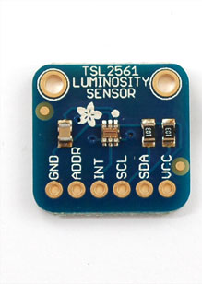
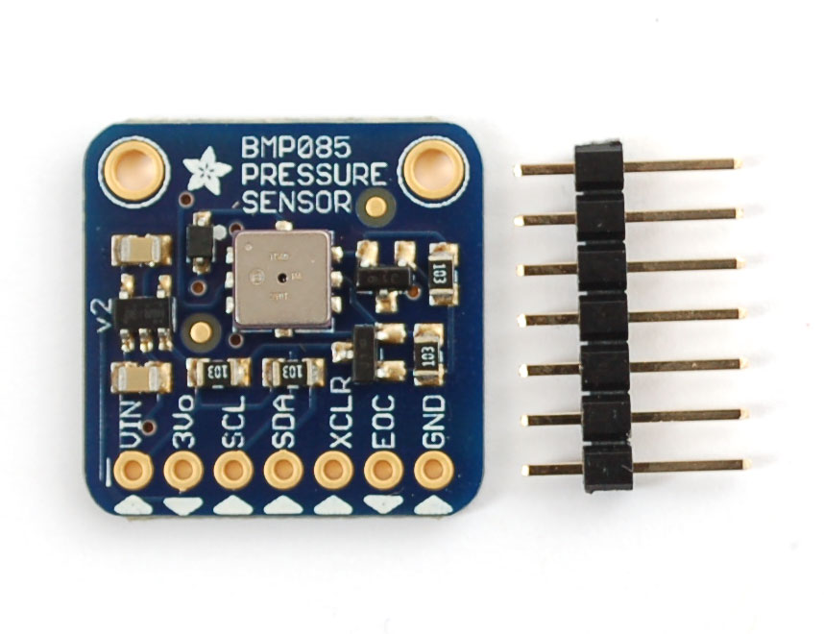
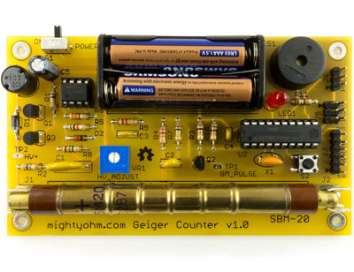
Shields and modules
Sensors and other modules:
Environment: Temperature, pressure, humidity
Geiger counter
Sounds
Movement: accelometer
Proximity: ultrasonic/IR/reflection
Biometric: finger prints/heart pulse
Light and colors
Flow
Force: pressure/bending
Extended ADC: e.g. 18bits
Notes:
Microcontroller: available components

Slide 21
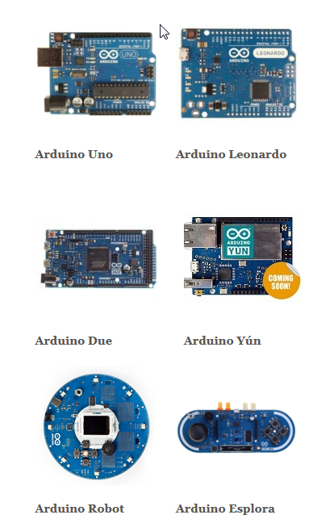
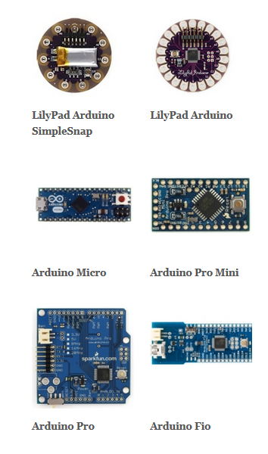
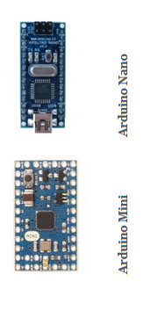
Meet the greater family

Slide 22
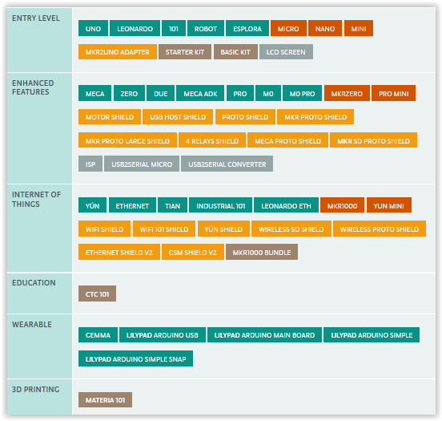
https://www.arduino.cc/en/Main/Products

Slide 23
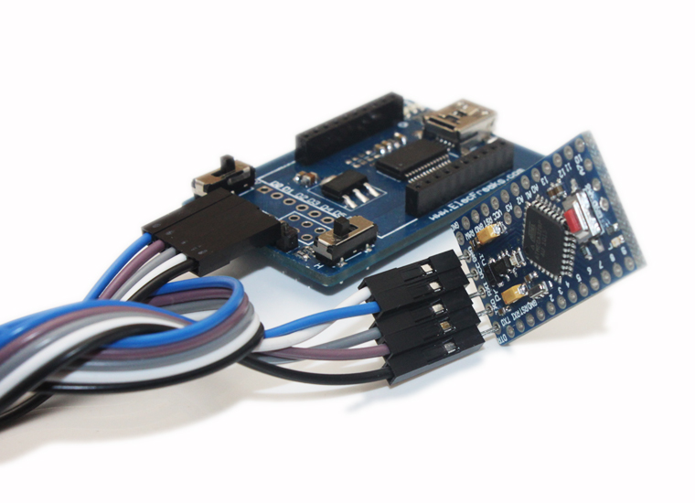
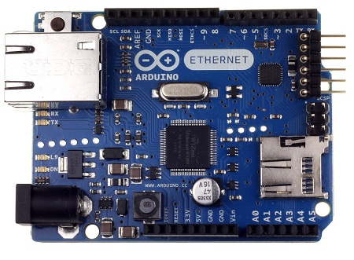
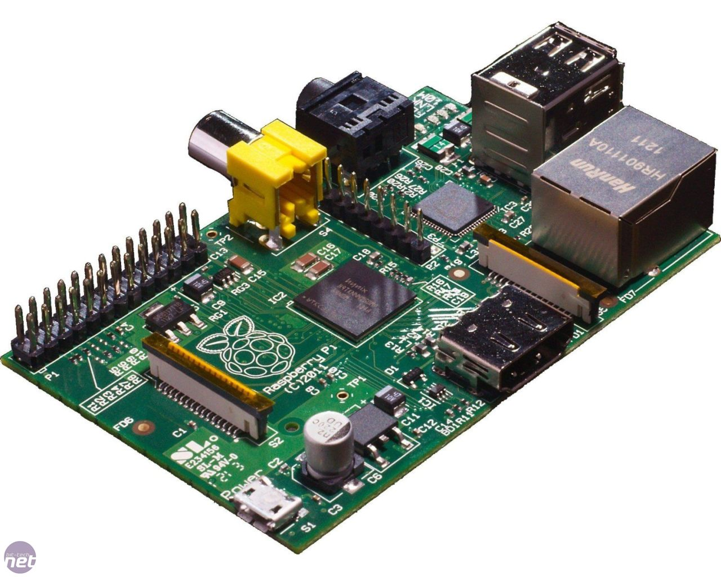
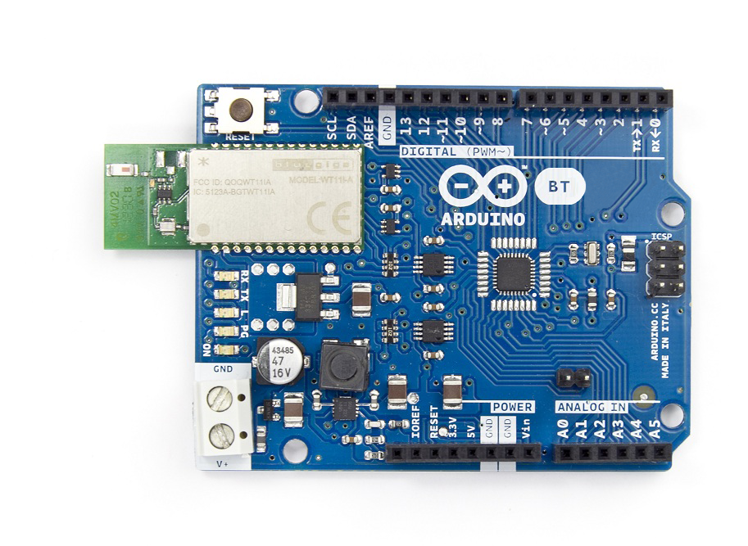
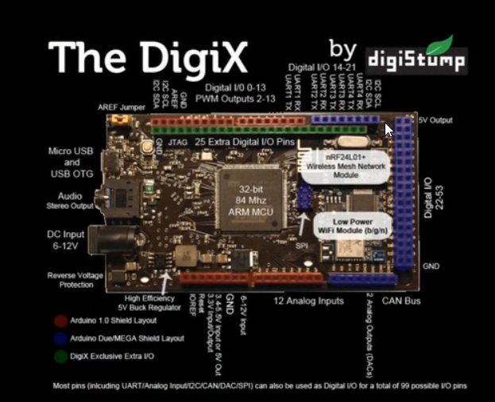
Raspberry Pi
OtherDuinos
http://en.wikipedia.org/wiki/List_of_Arduino_compatibles

Slide 24
Why Arduino?
Simple, clear programming environment
Open source Extensible: both hardware and software
Inexpensive
Cross-platform – windows, mac OSX, Linux
For scientists:
Science and engineering education
Control your experiments environment
Sensing and measuring experiment
Data logging
Accessible

Slide 25
?

